Slide 1
Network Research: Cultural Holes, Networks and Creativity

Slide 2
Flashback: Basic notions in two mode networks
Some terminology:
  A bipartite graph G= (V^{T}, V^{B}, E) is triplet consisting of
    "Top" nodes (V^{T})
    "Bottom" nodes (V^{B})
    And a set of edges (E)
    Nodes are in two disjoints sets such that links go from nodes in one set to nodes in the other
  Basic statistics
    Graph size: n = |V|
    Number of edges: m = |E|
    Average degree: 2m / n
    Density: 2m / (n(n-1))

Slide 3
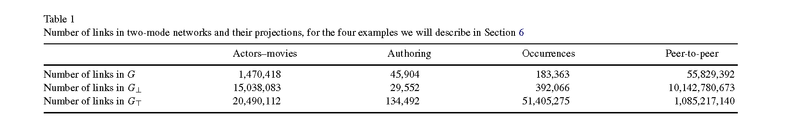
Flashback: Basic notions in two mode networks
Standard approaches to analyzing two-mode networks involve deriving the one-mode projection, this approach is not always ideal:
  Information loss: bipartite structure is lost after projection
  Artifactual properties: Clustering/density in the one-mode projection may not reflect the actual magnitude/presence of those properties in the two-mode network
  Edge inflation: m in the one-mode graph is much larger than in the bipartite graph (each actor/event contributes multi-edges)

Slide 4
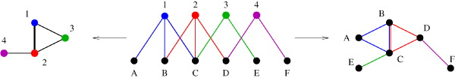
Extension of basic statistics to two mode networks
To deal with this issue Latapy and colleagues (2008) have proposed a “projection-free” approach for the analysis of (large) two-mode networks
This involves extending and finding analogues for:
  Basic statistics in the two-mode case
  Distributional analysis of degrees to the two mode case
  Notions of clustering for the two mode case

Slide 5
Extension of basic statistics to two mode networks
Number of (top) Nodes: n↑
Number of (bottom) Nodes: n↓
Number of edges: m.
Average (top) degree: k↑ = m/n↑
Average (bottom) degree: k↓ = m/n↓
Average Degree in the Bipartite graph:
  k = 2m / (n↑ + n↓)
Density in the two-mode graph:
  δ(G) = m / (n↑n↓)
Density in the Bipartite Graph:
  δ(G’) = 2m / (n↑ + n↓)(n↑ + n↓ - 1)

Slide 6
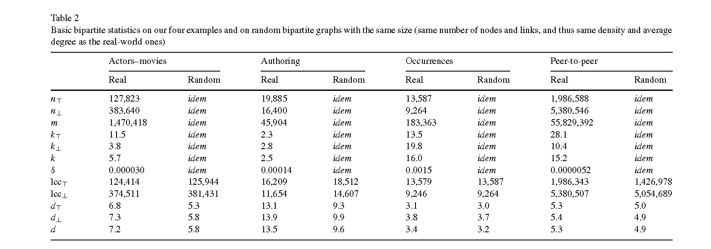
Extension of basic statistics to two mode networks

Slide 7
Extension of neighborhood notions
For a (top or bottom) node v, the immediate neighborhood N(v) is the number of nodes of a different type directly linked to it
We may extend that notion to the Distance-2 neighbors N(N(v))
  In the bipartite graph, these are the number of (top/bottom) nodes that a node of the same type can reach via a node of a different type
  Gets at the same information as centrality in the one-mode co-membership matrix without losing the bipartite structure

Slide 8
Extension of neighborhood notions
A key indicator of the "efficiency" with which a given node connects to others is given by:
  The correlation between a node's degree and the number of distance-2 neighbors compared to the same correlation in the corresponding random two-mode graph
  This information is usually lost in the one-mode projection

Slide 9


Extension of clustering notions
The clustering coefficient between any two nodes cc.(u, v) which belong to the same set (top or bottom) is given by the intersection of their one-step neighborhood divided by their union:
  This definition only applies to pair of nodes, but we want a measure of clustering at the node level
  We can do this by taking the average of clustering between u's distance-2 neighbors:

Slide 10


Extension of clustering notions
We can follow a similar approach to define the average clustering for all top nodes:
And the average clustering for all bottom nodes:
Total graph clustering:
  cc(G) = (n↑cc.(↑) + n↓cc.(↓)) / (n↑n↓)

Slide 11


Extension of clustering notions
When there is heterogeneity in the (top or bottom) degree, the standard intersection over union strategy to measure dyadic clustering may not be effective
  It is likely that one node's neighborhood will be completely swamped by the other
In this case, a “min” or “max” clustering strategy may be most appropriate:

Slide 12


Extension of clustering notions

Slide 13
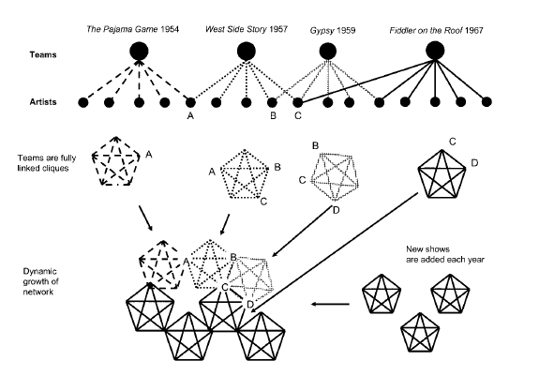
Uzzi & Spiro: Small worlds and creative success
Two countervailing small world mechanisms in creative worlds
  Structural:
    Links between clusters aid diffusion of ideas
  Relational:
    Links between clusters made up of repeated ties and third-party ties create cohesion between producers
Important to think about how structure is assembled over time

Slide 14
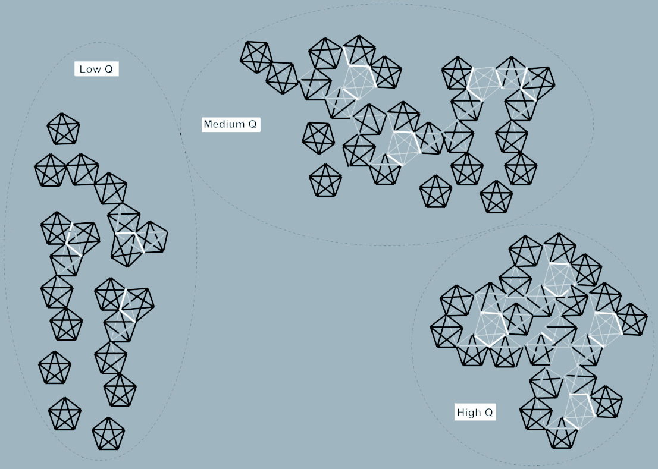
Uzzi & Spiro: Small worlds and creative success
Clustering, small worlds and communicative efficiency
  SW connectivity allows creative material to circulate to other clusters
Short cuts between clusters
Small world network
  Short average path length
  PL ratio = PL_{actual}/Pl_{random} --> 1
  High clustering
    CC ratio = CC_{actual}/CC_{random} > 1
    Q = CC ratio/PL ratio

Slide 15
Uzzi & Spiro: Small worlds and creative success
Clustering, small worlds and communicative efficiency
  SW connectivity allows creative material to circulate to other clusters
Short cuts between clusters
Small world network
  High Q worlds:
    Cohesion dominates over diffusion
    Facilitates collaboration
    But inhibits innovation and the generation of new ideas

Slide 16
Uzzi & Spiro: Small worlds and creative success
Clustering, small worlds and communicative efficiency
  SW connectivity allows creative material to circulate to other clusters
Short cuts between clusters
Small world network
  Low Q worlds:
    Relatively disconnected structure
    Some paths for diffusion
    But low cohesion hinders coordination and learning within teams make them less efficient

Slide 17
Uzzi & Spiro: Small worlds and creative success
Clustering, small worlds and communicative efficiency
  SW connectivity allows creative material to circulate to other clusters
Short cuts between clusters
Small world network
  Medium Q Worlds:
    Goldilocks: Best of both worlds
    Enough cohesion to leverage learning and familiarity with repeat collaborators
    Enough diffusion to access new ideas

Slide 18
Uzzi & Spiro: Small worlds and creative success
Success = f(convention, innovation)
  Clustering leads to convention and lack of novelty
Between-cluster connections:
  Diffusion of innovations
    But weak ties
Between-cluster w/ pairing:
  Risk taking and adoption of innovation
Implication:
  Inverted U-shape relation between Q and success

Slide 19
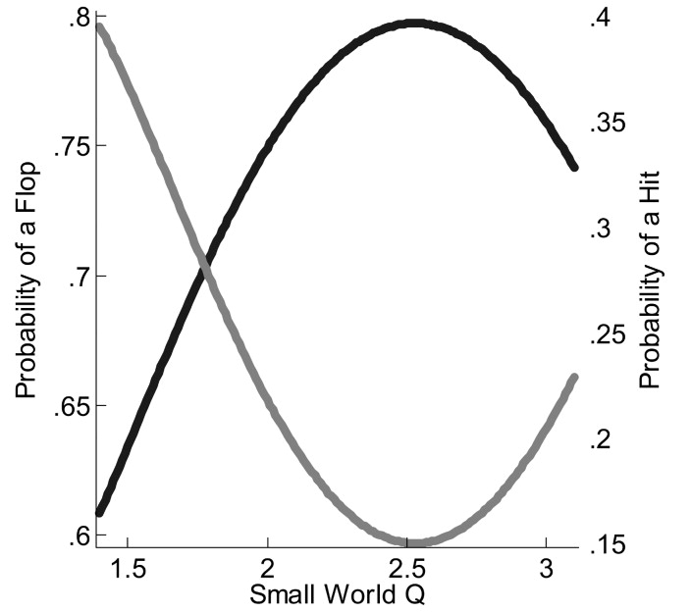
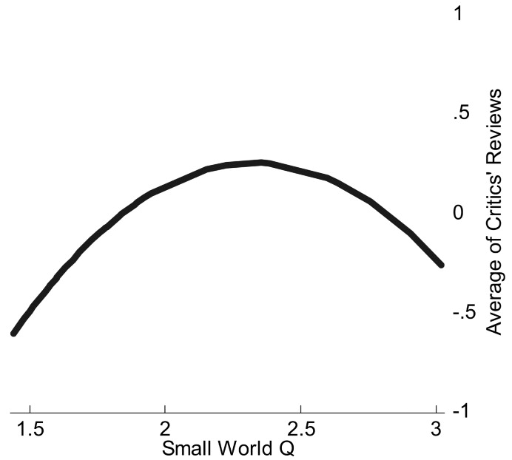
Financial success of a show

Slide 20
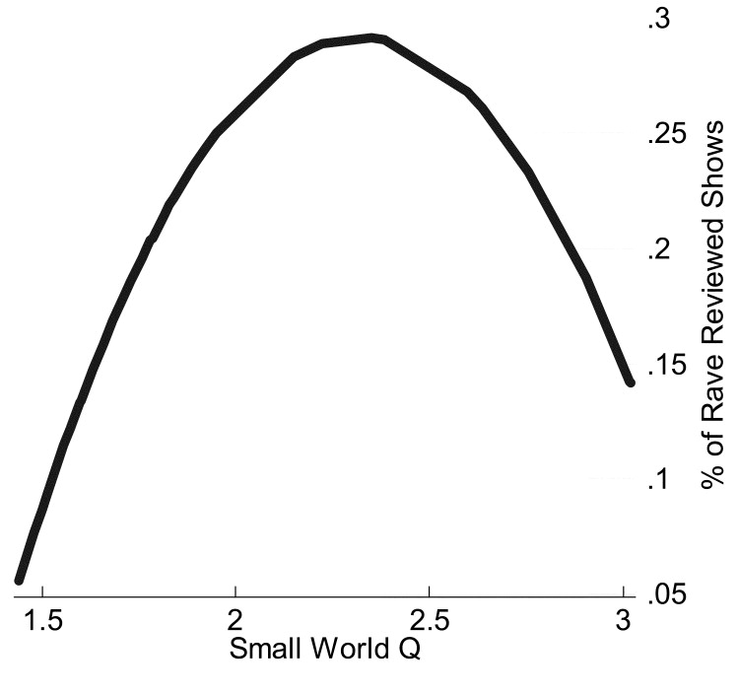
Financial success of a show

Slide 21
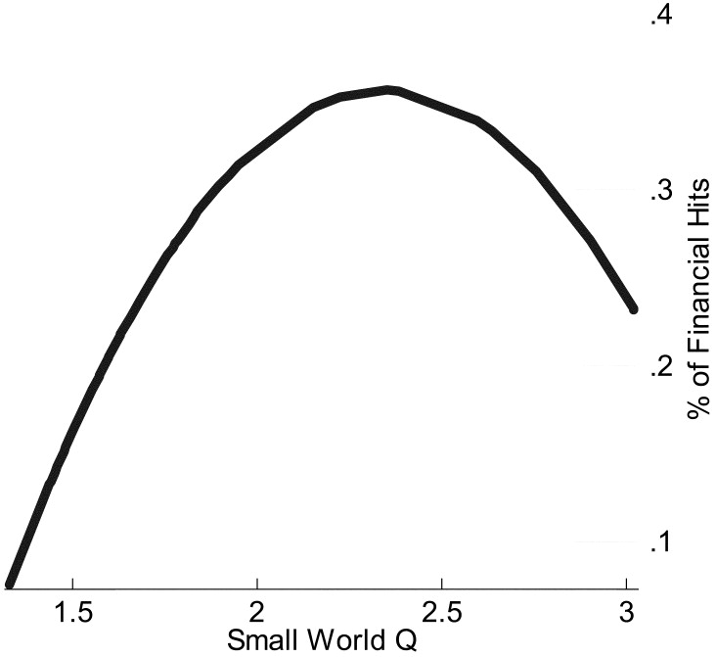
Financial success of a show

Slide 22
Askin and Mauskapf: Product features and success
Key insight:
  Features of cultural products form a network
    C_{ij} = 1 if feature i can be found in product j
A product feature similarity network can be constructed from such data:
  S_{ij} = cos(C_{i,} C_{j})
Were each entry in the similarity matrix is product i’s feature vector cosine distance from product j
  Products that occupy the same “position” in the feature network are similar
Key idea:
  At any given time product need to be “optimally distinct” from competitors
    Too similar and they are dismissed
    Too different and they are incomprehensible

Slide 23
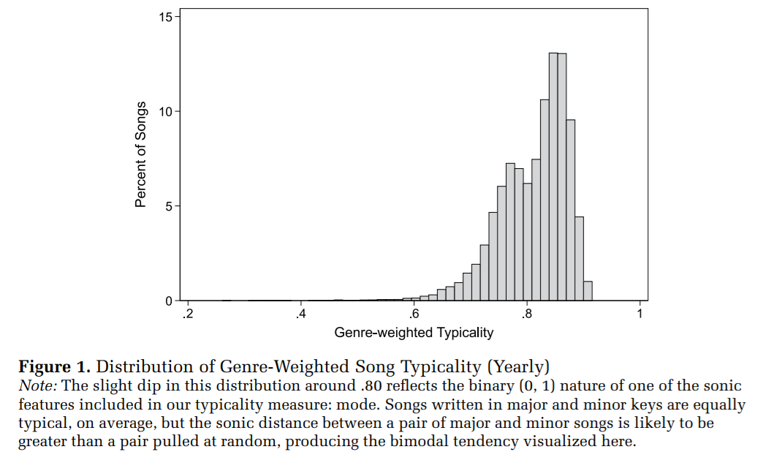
Askin and Mauskapf: Product features and success

Slide 24
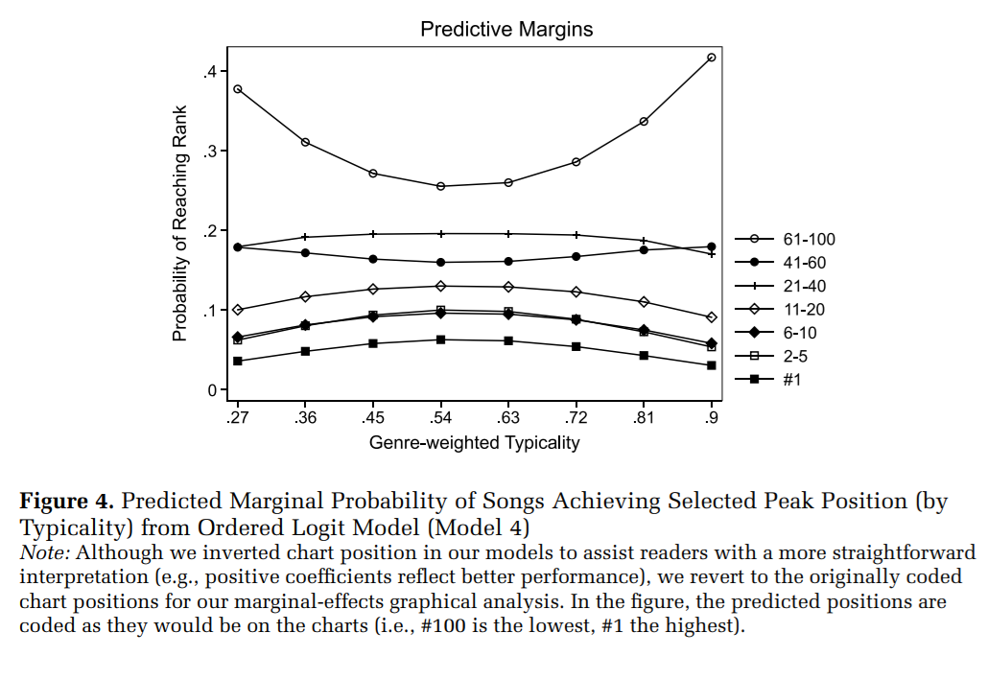
Askin and Mauskapf: Product features and success

Slide 25
The “cultural holes” argument
Riff on Burt’s idea of “structural holes”
Structural holes are absent links in the social structure
  Person to person relations
Cultural holes are absent link in the “cultural structure”
  Relations between cultural entities
Analogue to bridging between disconnected parts of a cultural network
  Two mode network imagery
    Persons bridging between cultural genres
    Scientists bridging between specialties
What is culture?
  Anything that can be communicated or serve as the basis for interaction

Slide 26
The “cultural holes” argument
Riff on Burt’s idea of “structural holes”
Structural holes are absent links in the social structure
  Person to person relations
Cultural holes are absent link in the “cultural structure”
  Relations between cultural entities
Basic idea:
  Communication across cultural holes is harder (Vilhena et al 2014)
    Two engineers can talk to one another more efficiently
    A rock and roll fan can talk to a fan of folk music more easily than a fan of rap
  But being a broker between cultural holes can be good

Slide 27
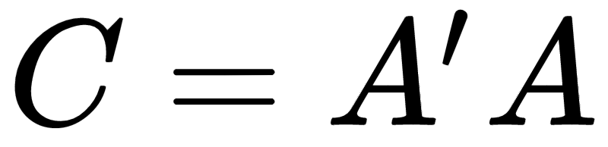
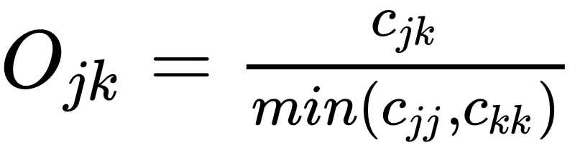
Measuring cultural holes
Measures of cultural holes can be extracted from any two-mode data
  Including “two mode” data taken from social science (persons x variables) surveys
Consider a two-mode network of persons X cultural activities
  How strongly are cultural items connected in this network?
  A person bridges a “cultural hole” if s/he chooses items that are not strongly connected
  Cultural item projection matrix:
    Where A is the original two-mode adjancecy matrix
    Entries c_{jk} are the number of persons that choose cultural items j and k
    Entries c_{jj} are the number of persons that choose cultural item j
    Weighted cultural item network is then given by:
      Latapy et al’s (2008) “min overlap” measure

Slide 28
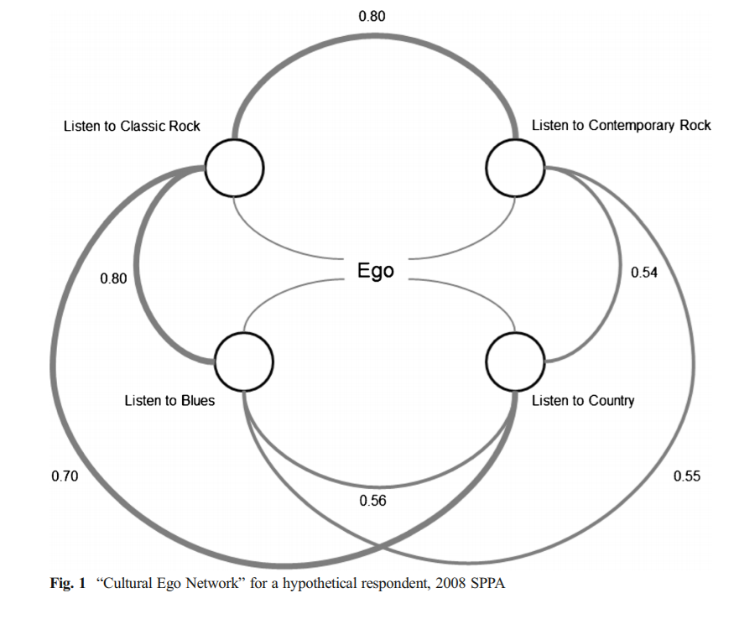
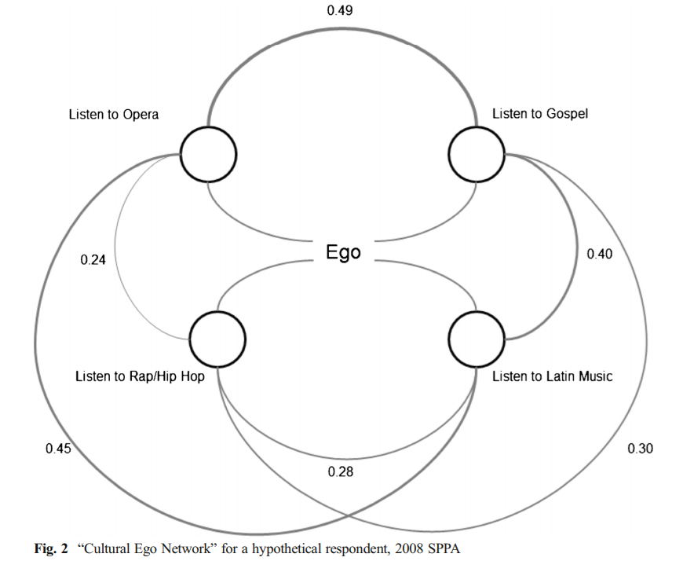
Measuring cultural holes: Cultural ego networks
Lizardo, O. (2014). Omnivorousness as the bridging of cultural holes: A measurement strategy. Theory and Society, 43(3-4), 395-419.

Slide 29
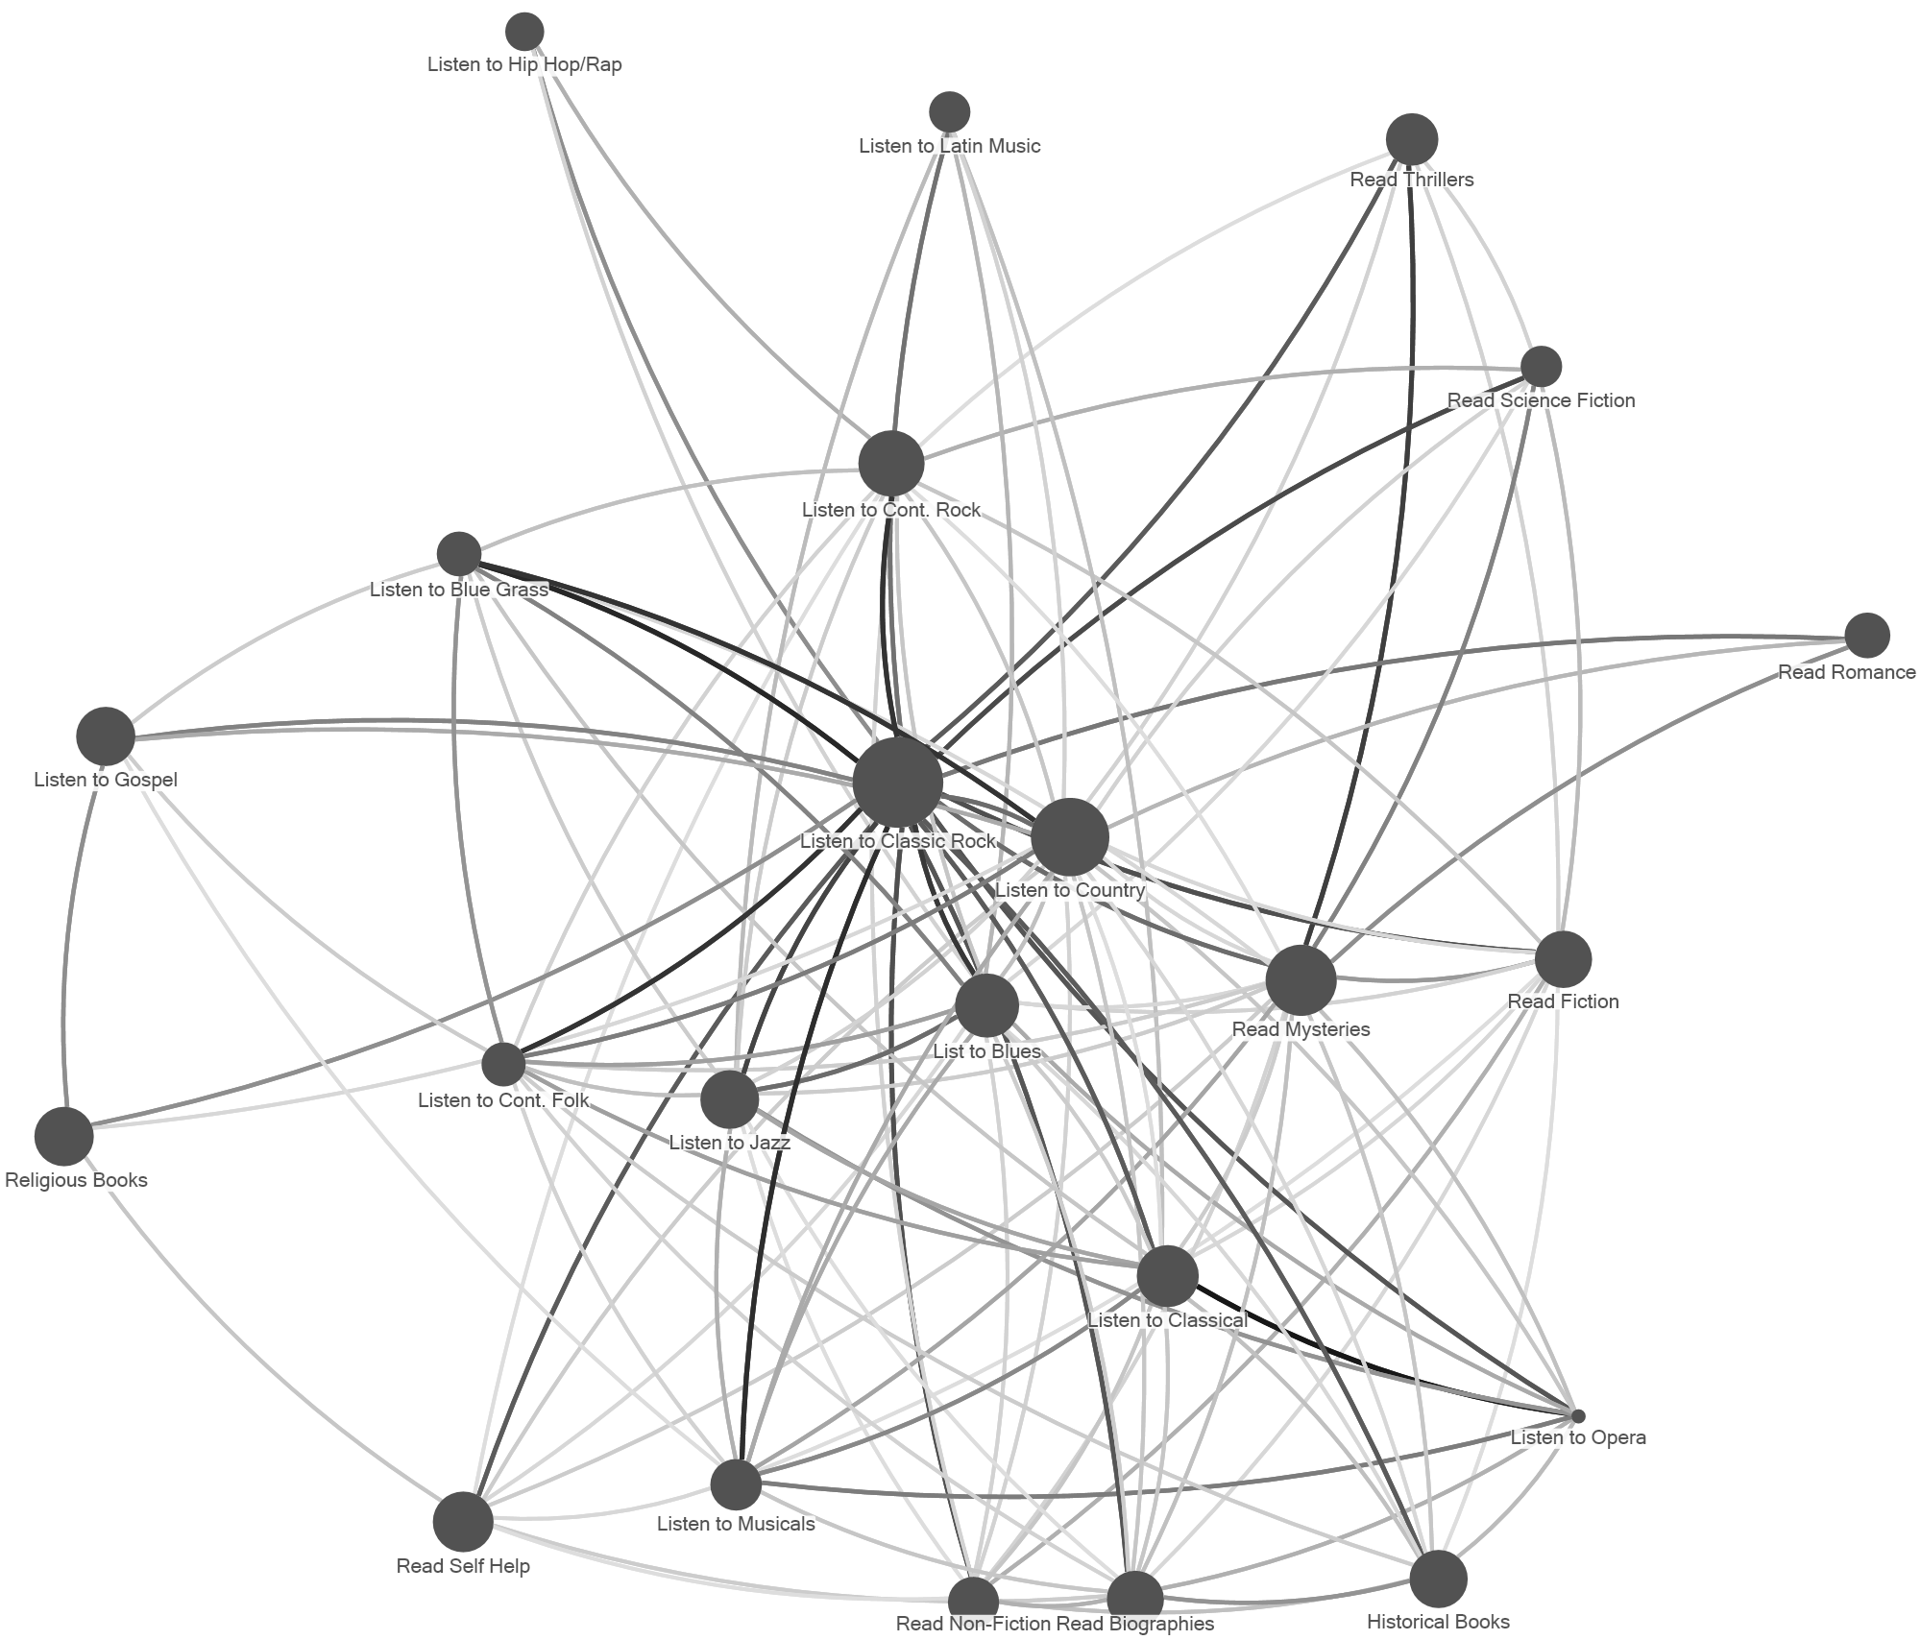
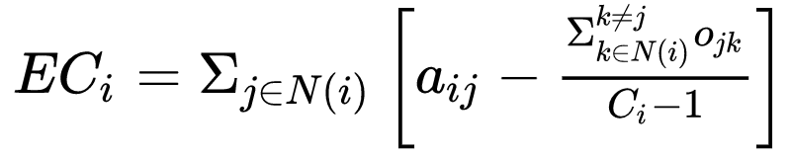
Measuring cultural holes
After we have the overlap cultural network we can calculate a person’s effective two-mode degree centrality:
Where C_{i} is the number of cultural items chosen by person i and a_{ij} = 1 if person i chooses item j

Slide 30
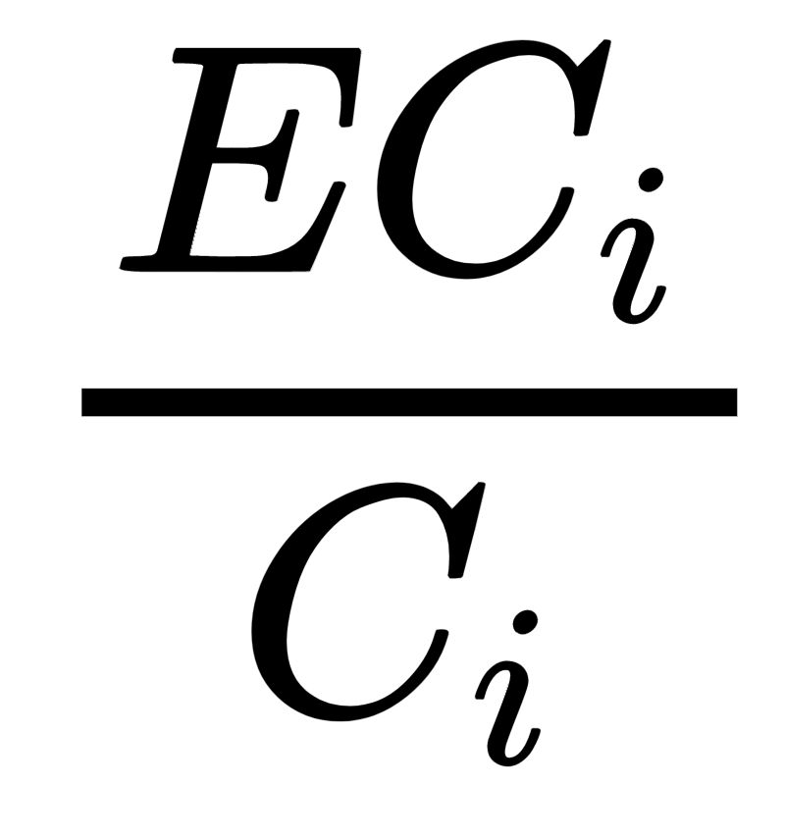
Measuring cultural holes
After we have the overlap cultural network we can calculate a person’s effective two-mode degree centrality:
Cultural Network Efficiency is then:

Slide 31
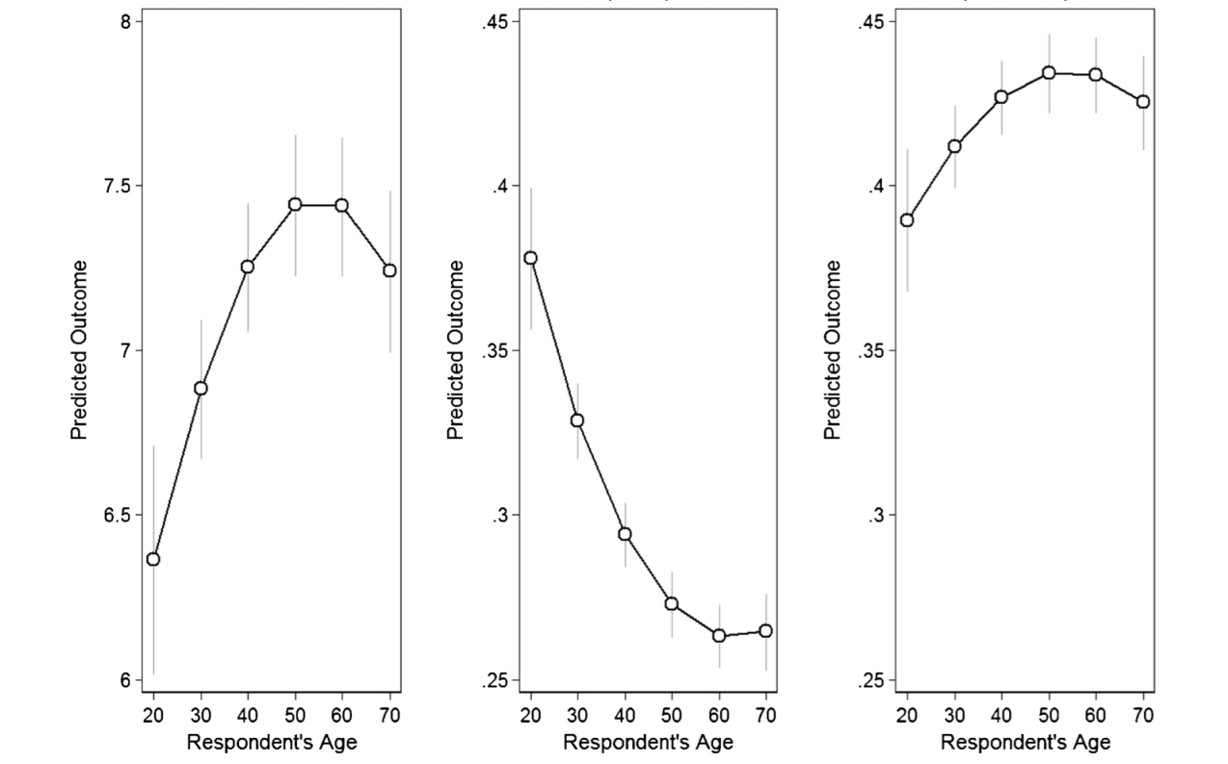
Measuring cultural holes
C_{i}
EC_{i}
C_{i} (rand)

Slide 32
Advanced centrality notions in two mode networks
A distinctive feature of centrality scores in two-mode networks is that the scores in one-mode depend on the scores in the other mode
Hidalgo and Hausman (2009) show that this principle can be generalized to compute a set of recursive quantities that they refer to as the method of reflections
  Different "levels" of reflection modify the substantive interpretation of a given centrality score across the two modes
  Gives us a different take on “bridging” across cultural and structural holes in two mode networks

Slide 33




Advanced centrality notions in two mode networks
Consider the standard two-mode data matrix (A_{ik}) with modes g and h.
Reflective centralities are given by the quantities:
with:

Slide 34
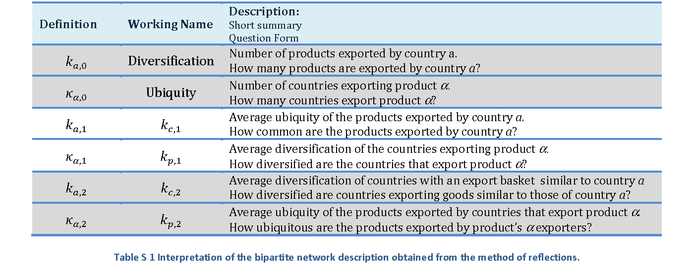
Advanced centrality notions in two mode networks

Slide 35
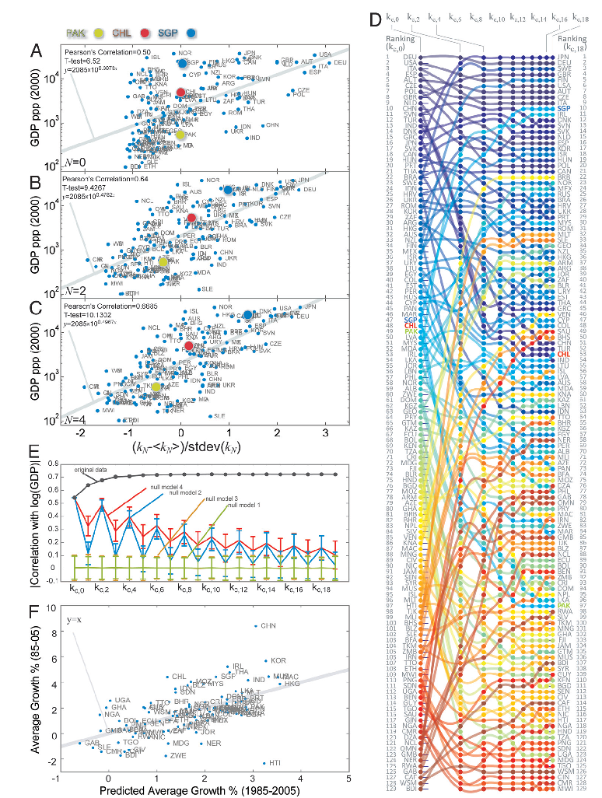
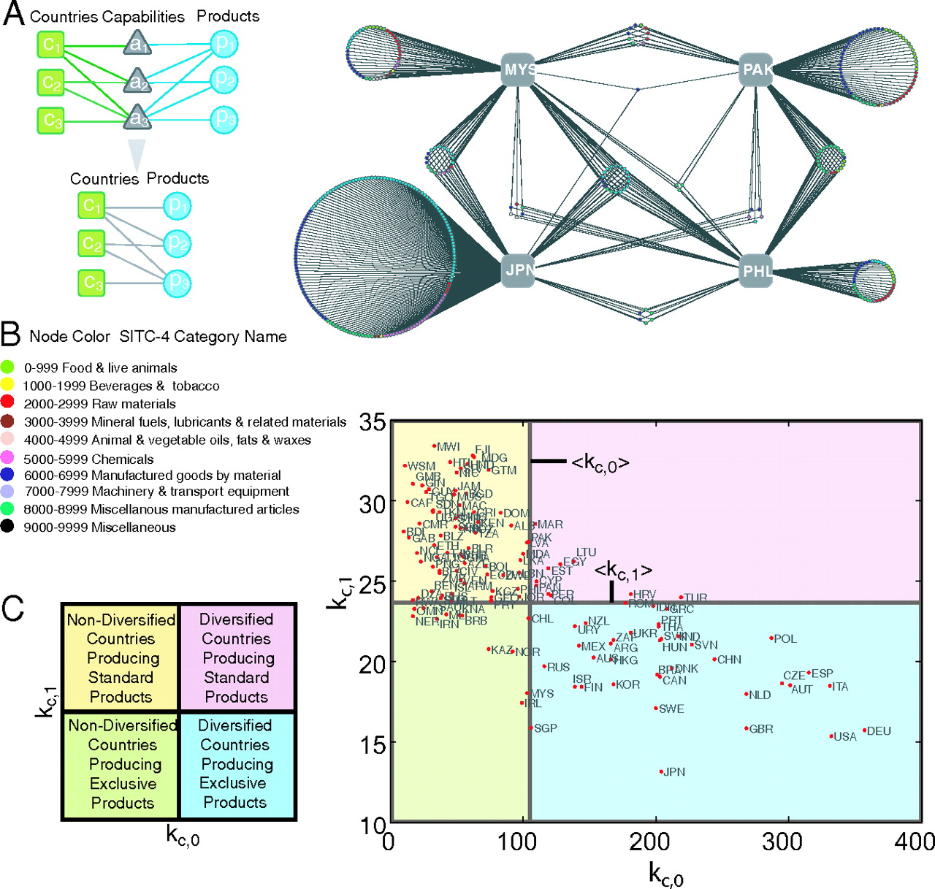

Slide 36
